Slide 1
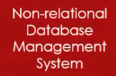

NoSQL(Not Only SQL) Database

Slide 2










NoSQL(Not Only SQL) Database

Slide 3
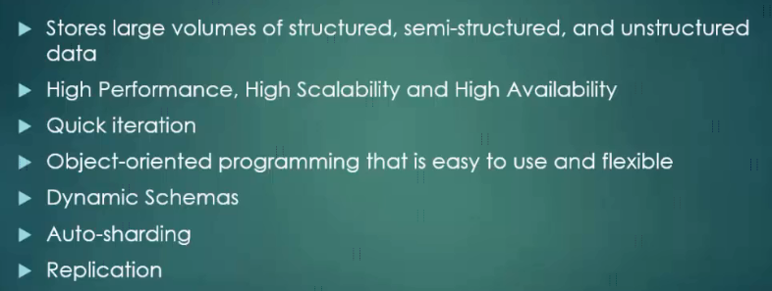
NoSQL(Not Only SQL) Database

Slide 4
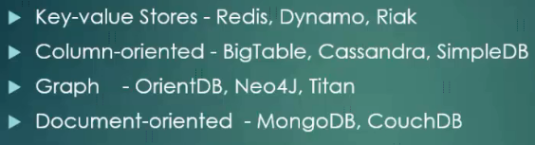
NoSQL(Not Only SQL) Database

Slide 5
NoSQL(Not Only SQL) Database
E:\udemy\Learn MongoDB Leading NoSQL Database from scratch\[Tutsgalaxy.com] - Learn MongoDB Leading NoSQL Database from scratch\02 Introduction to NoSQL Database

